Slide 1
Hill Cipher
An encryption algorithm based on linear algebra

Slide 2
Some important ideas
Algorithms
Space and time complexity
Public key cryptography
Block ciphers
Matrices & operations on matrices (multiplication, inverse, adjoint, and cofactor

Slide 3
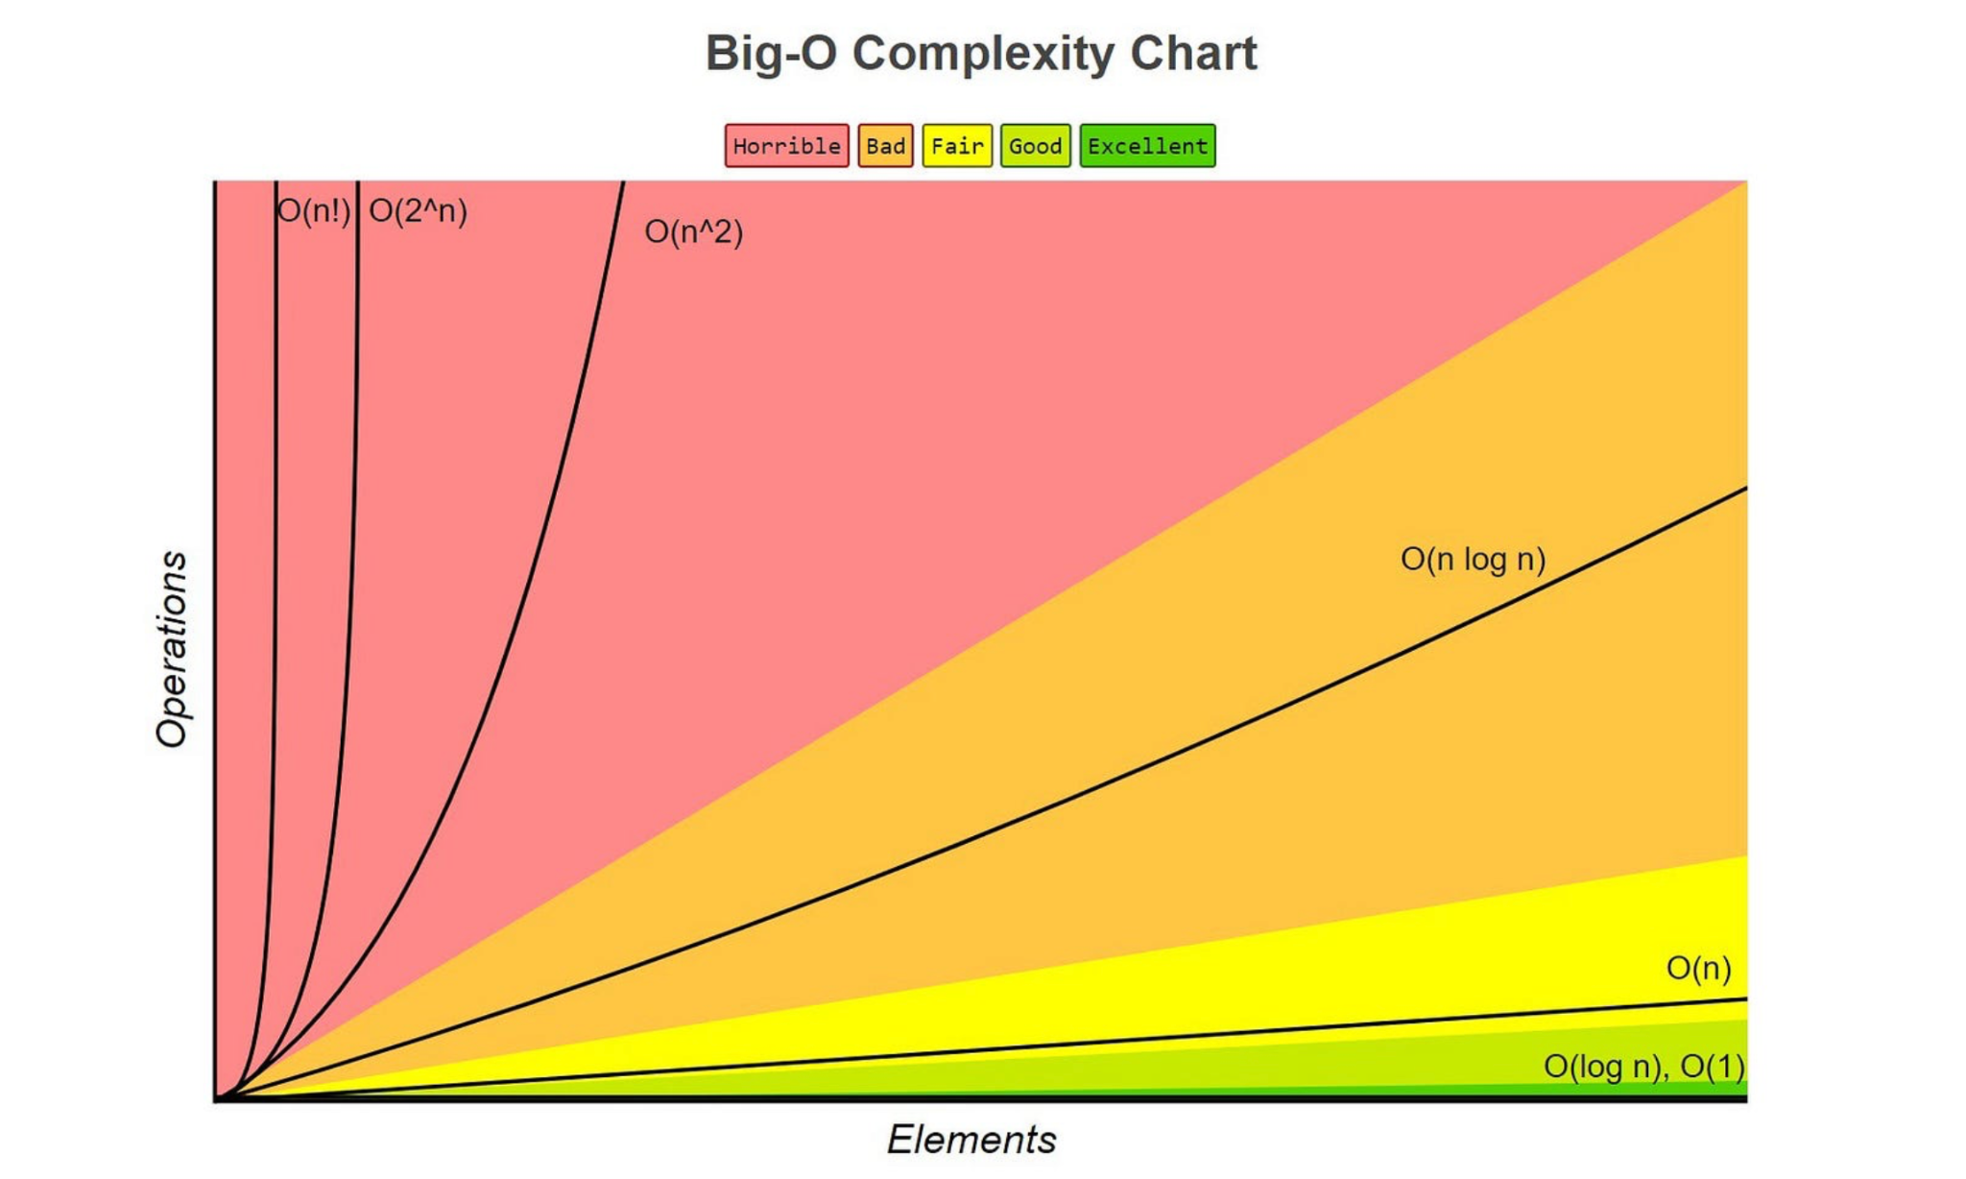
Space and time complexity

Slide 4
What is an encryption algorithm
An encryption algorithm essentially takes user input/user data and transforms it into non human-readable text/data.
For instance, a very simple shift algorithm (make each letter the succeeding letter in the alphabet, e.g.: a->b) converts “Encryption” into “Fodszqujpo”.

Slide 5
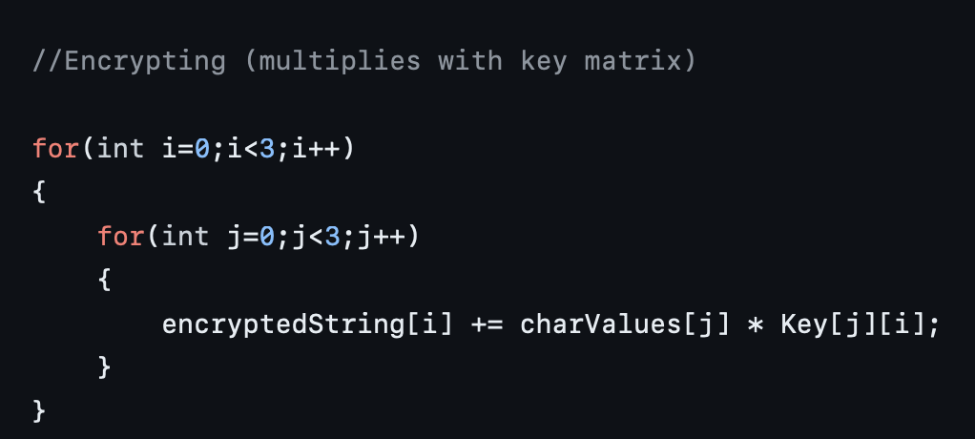
Matrix multiplication algorithm

Slide 6
Matrix multiplication Computational Complexity
Time complexity : O(n²) (Quadratic)
Space complexity: O(n)
While the time complexity is quadratic, it’s the most efficient solution . optimizing the matrix multiplication algorithm is a major open question in theoretical computer science¹
1- Wikipedia: Computational complexity of matrix multiplication

Slide 7

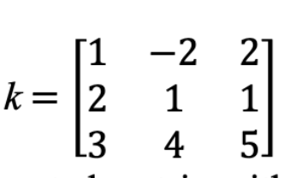
Encrypting Using Hill Cipher
Uses basic concept of matrix multiplication. The program:
My program takes a user-entered plaintext message, convert it into an ASCII-based matrix, and encrypt in blocks of 3 letters at a time by multiplying the ASCII-based matrix and the key matrix

Slide 8
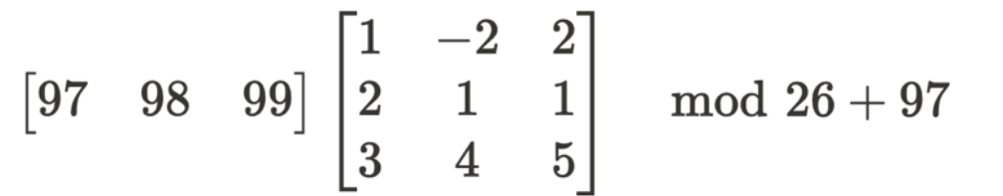
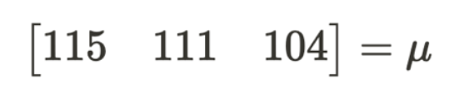
s
o
h

Slide 9
The full story
How does the program break the sentence/word into blocks?
How does the program glue all the encrypted text back together?
User-inputted text can be weird.
How do you deal with spaces (the “space” character, called a whitespace, also has an ASCII value). So how do we prevent this from wrongfully impacting ultimate encrypted text?
Not all user-inputted sentences or words will be perfect multiples of three, so what happens when we have extra/lesser number of words than a multiple of 3?

Slide 10
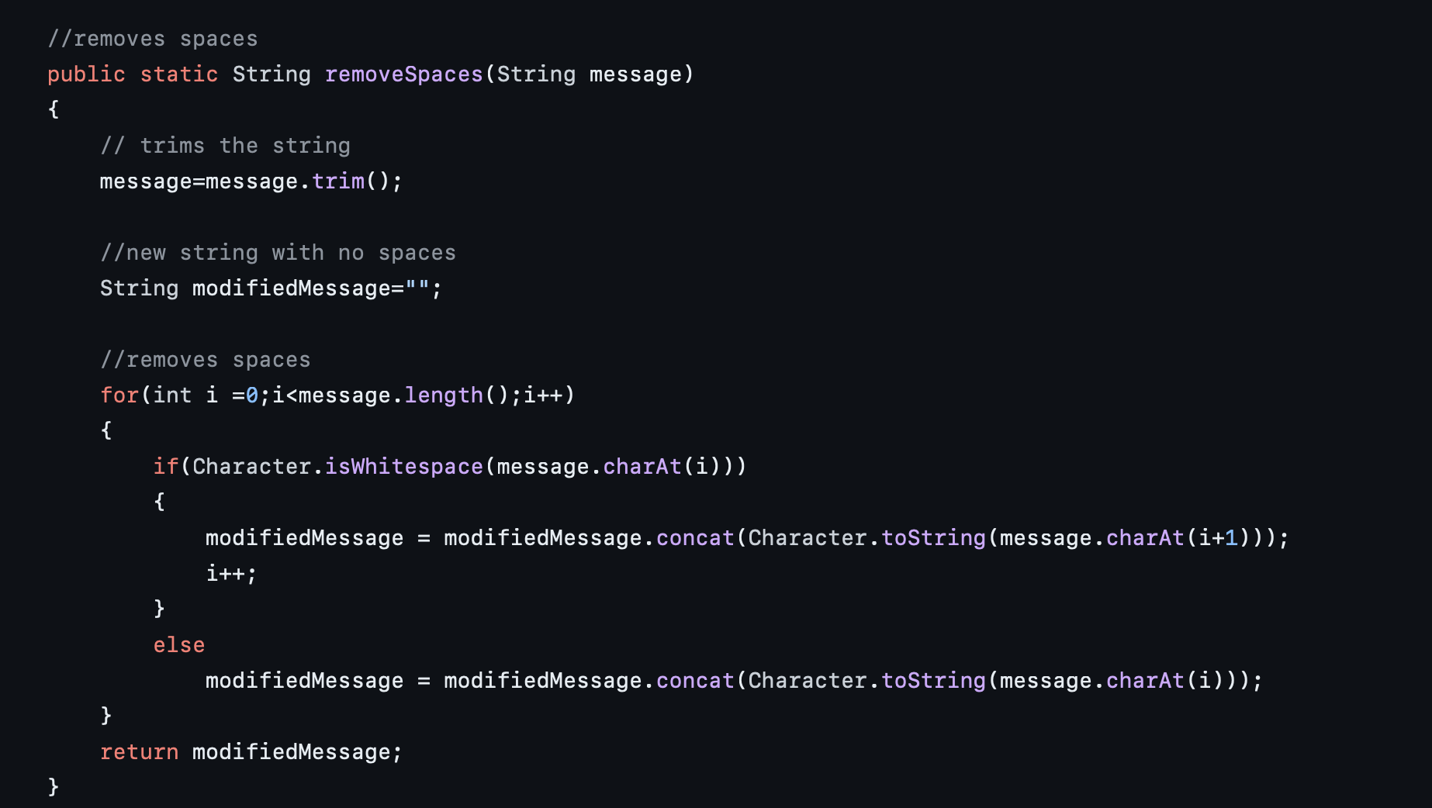

Slide 11
Computational complexity of removeSpaces
Time complexity : O(n)
Space complexity: O(n)
The time complexity of this function is fairly efficient.
However, the space complexity can be improved.
For instance, I could use Java libraries like StringTokenizer or StringBuilder to make it much more space-efficient, which will allow this program to deal with larger input messages much better

Slide 12
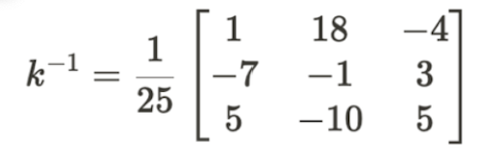
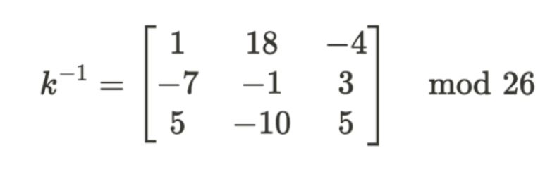
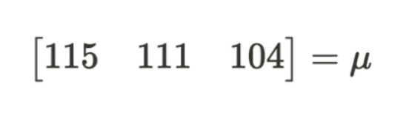
Decrypting Using Hill Cipher

Slide 13
A confession
This semester, I wanted to focus on encrypting user-inputted data.
But this project is only half complete, technically.
While I was successful in encrypting the user-inputted text, decrypting it is a whole different story. While I tried forming an algorithm for this as well, for some reason, the decryption algorithm.
The decryption algorithm requires concepts from modular arithmetic, which I will be taking next semester (MAT243: Discrete Math), which is when I will be able to fully finish this project.

Slide 14
Q & A

Slide 15

Thanks!

